Slide 1
Chapter 4
Threads
Operating Systems:
Internals and Design Principles
Seventh Edition
By William Stallings
Notes:
“Operating Systems: Internal and Design Principles”, 7/e, by William Stallings, Chapter 4 “Threads”.

Slide 2

Operating Systems:
Internals and Design Principles
The basic idea is that the several components in any complex system will perform particular subfunctions that contribute to the overall function.
—THE SCIENCES OF THE ARTIFICIAL,
Herbert Simon
Notes:
This chapter examines some more advanced concepts related to process management, which are found in a number of contemporary operating systems. We show that the concept of process is more complex and subtle than presented so far and in fact embodies two separate and potentially independent concepts: one relating to resource ownership and another relating to execution. This distinction has led to the development, in many operating systems, of a construct known as the thread .

Slide 3
Processes and Threads
Traditional processes have two characteristics:
Resource Ownership
Scheduling/Execution
  Process includes a virtual address space to hold the process image
    the OS provides protection to prevent unwanted interference between processes with respect to resources
Follows an execution path that may be interleaved with other processes
  a process has an execution state (Running, Ready, etc.) and a dispatching priority and is scheduled and dispatched by the OS
  Traditional processes are sequential; i.e. only one execution path

Slide 4

Processes and Threads
Multithreading - The ability of an OS to support multiple, concurrent paths of execution within a single process
The unit of resource ownership is referred to as a process or task
The unit of dispatching is referred to as a thread or lightweight process
Notes:
To distinguish the two characteristics, the unit of dispatching is usually referred to as a thread or lightweight process , while the unit of resource ownership is usually referred to as a process or task .
Multithreading refers to the ability of an OS to support multiple, concurrent paths of execution within a single process.

Slide 5
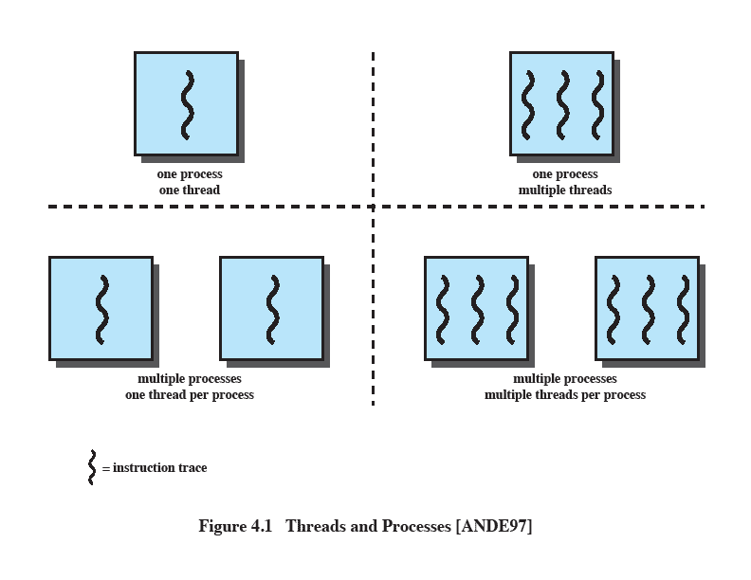
Single Threaded Approaches
A single execution path per process, in which the concept of a thread is not recognized, is referred to as a single-threaded approach
MS-DOS, some versions of UNIX supported only this type of process.
Notes:
The traditional approach of a single thread of execution per process, in which the concept of a thread is not recognized, is referred to as a single-threaded approach. The two arrangements shown in the left half of Figure 4.1 are single-threaded approaches. MS-DOS is an example of an OS that supports a single user process and a single thread.

Slide 6
Multithreaded Approaches
The right half of Figure 4.1 depicts multithreaded approaches
A Java run-time environment is a system of one process with multiple threads; Windows, some UNIXes, support multiple multithreaded processes.
Notes:
The right half of Figure 4.1 depicts multithreaded approaches. A Java run-time environment is an example of a system of one process with multiple threads. Of interest in this section is the use of multiple processes, each of which supports multiple threads. This approach is taken in Windows, Solaris, and many modern versions of UNIX, among others. In this section we give a general description of multithreading; the details of the Windows, Solaris, and Linux approaches are discussed later in this chapter.

Slide 7

Processes
In a multithreaded environment the process is the unit that owns resources and the unit of protection.
  i.e., the OS provides protection at the process level
Processes have
  A virtual address space that holds the process image
  Protected access to
  processors
  other processes
  files
  I/O resources
Notes:
In a multithreaded environment, a process is defined as the unit of resource allocation and a unit of protection. The following are associated with processes:
• A virtual address space that holds the process image
• Protected access to processors, other processes (for interprocess communication), files, and I/O resources (devices and channels)

Slide 8

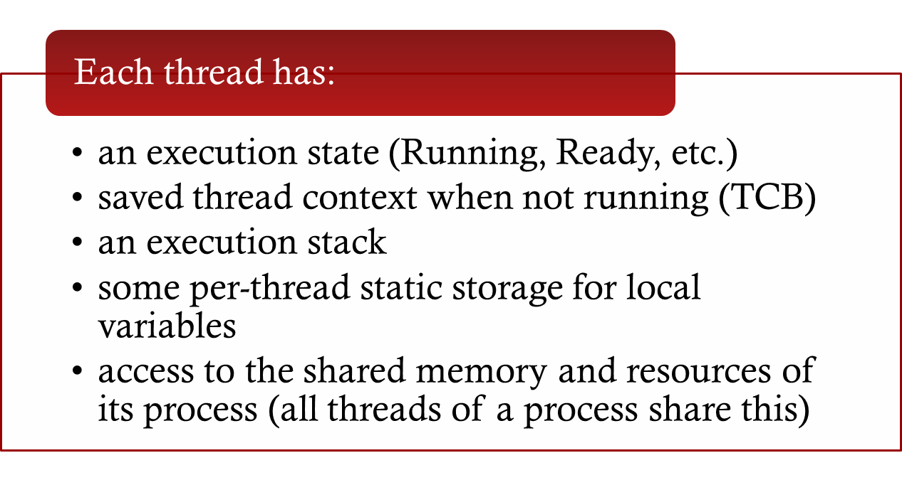
One or More Threads in a Process
Notes:
Within a process, there may be one or more threads, each with the following:
• A thread execution state (Running, Ready, etc.)
• A saved thread context when not running; one way to view a thread is as an independent program counter operating within a process
• An execution stack
• Some per-thread static storage for local variables
• Access to the memory and resources of its process, shared with all other threads in that process

Slide 9
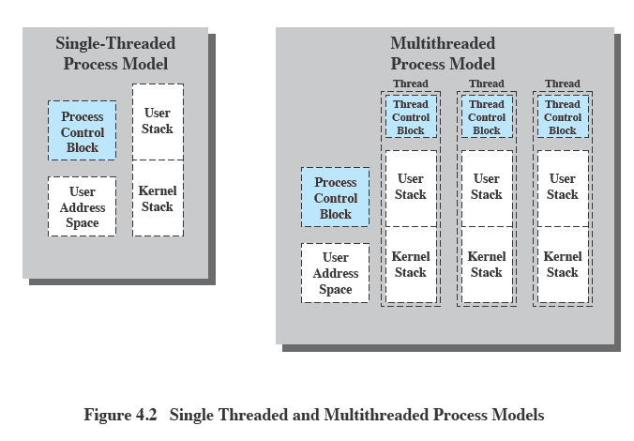
Threads vs. Processes
Notes:
Figure 4.2 illustrates the distinction between threads and processes from the point of view of process management. In a single-threaded process model (i.e., there is no distinct concept of thread), the representation of a process includes its process control block and user address space, as well as user and kernel stacks to manage the call/return behavior of the execution of the process. While the process is running, it controls the processor registers. The contents of these registers are saved when the process is not running. In a multithreaded environment, there is still a single process control block and user address space associated with the process, but now there are separate stacks for each thread, as well as a separate control block for each thread containing register values, priority, and other thread-related state information.

Slide 10
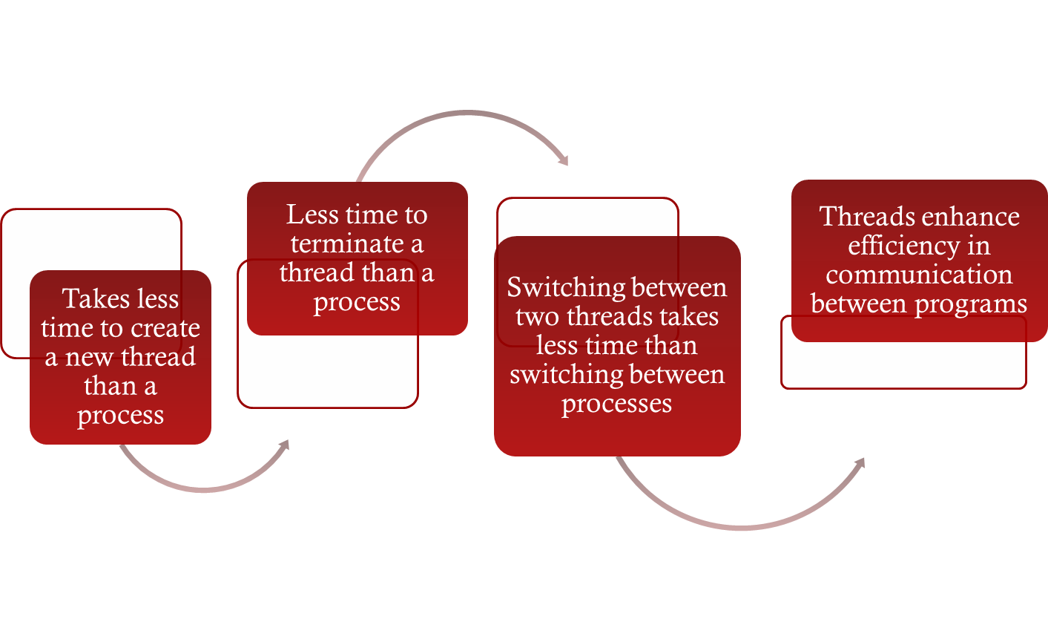
Benefits of Threads
Notes:
Thus, all of the threads of a process share the state and resources of that process. They reside in the same address space and have access to the same data. When one thread alters an item of data in memory, other threads see the results if and when they access that item. If one thread opens a file with read privileges, other threads in the same process can also read from that file.
The key benefits of threads derive from the performance implications:
1. It takes far less time to create a new thread in an existing process than to
create a brand-new process. Studies done by the Mach developers show that
thread creation is ten times faster than process creation in UNIX [TEVA87].
2. It takes less time to terminate a thread than a process.
3. It takes less time to switch between two threads within the same process than to switch between processes.
4. Threads enhance efficiency in communication between different executing programs. In most operating systems, communication between independent processes requires the intervention of the kernel to provide protection and the mechanisms needed for communication. However, because threads within the same process share memory and files, they can communicate with each other without invoking the kernel.
Thus, if there is an application or function that should be implemented as a set of related units of execution, it is far more efficient to do so as a collection of threads rather than a collection of separate processes.

Slide 11
Benefits
Responsiveness – may allow continued execution if part of process is blocked, especially important for user interfaces
Resource Sharing – threads share resources of process, easier than shared memory or message passing
Economy – cheaper than process creation, thread switching lower overhead than context switching
Scalability – process can take advantage of multiprocessor architectures

Slide 12

Thread Use in a
Single-User System
Foreground and background work
Asynchronous processing
Speed of execution
Modular program structure
Notes:
[LETW88] gives four examples of the uses of threads in a single-user multiprocessing system:
• Foreground and background work: For example, in a spreadsheet program,
one thread could display menus and read user input, while another thread executes user commands and updates the spreadsheet. This arrangement often increases the perceived speed of the application by allowing the program to prompt for the next command before the previous command is complete.
• Asynchronous processing: Asynchronous elements in the program can be
implemented as threads. For example, as a protection against power failure, one can design a word processor to write its random access memory (RAM) buffer to disk once every minute. A thread can be created whose sole job is periodic backup and that schedules itself directly with the OS; there is no need for fancy code in the main program to provide for time checks or to coordinate input and output.
• Speed of execution: A multithreaded process can compute one batch of data
while reading the next batch from a device. On a multiprocessor system, multiple threads from the same process may be able to execute simultaneously. Thus, even though one thread may be blocked for an I/O operation to read in a batch of data, another thread may be executing.
• Modular program structure: Programs that involve a variety of activities or a
variety of sources and destinations of input and output may be easier to design and implement using threads.

Slide 13

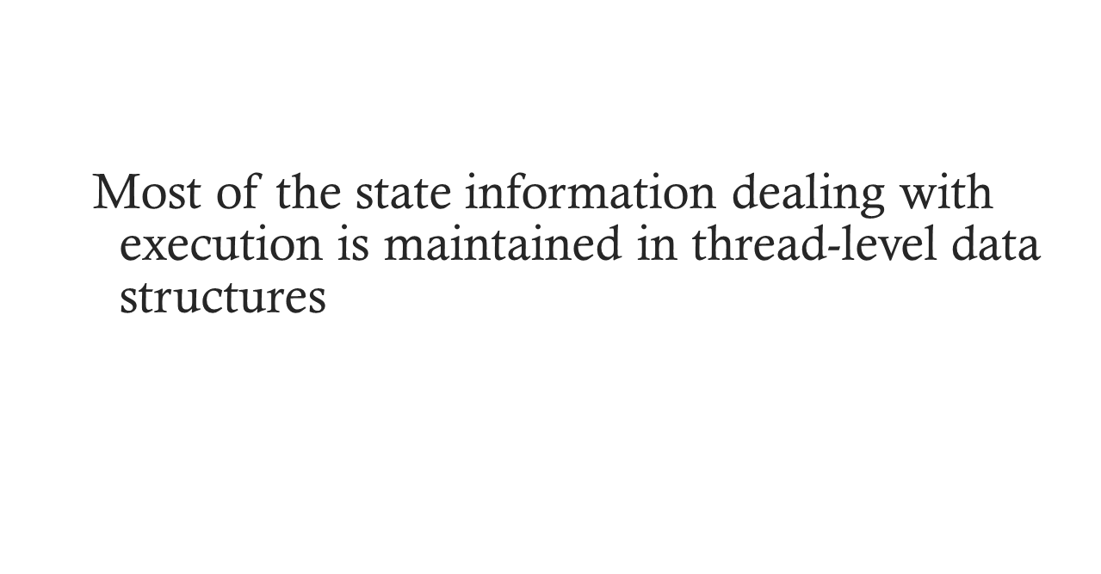

In an OS that supports threads, scheduling and dispatching is done on a thread basis
  suspending a process involves suspending all threads of the process
  termination of a process terminates all threads within the process
Notes:
In an OS that supports threads, scheduling and dispatching is done on a thread basis; hence, most of the state information dealing with execution is maintained in thread-level data structures. There are, however, several actions that affect all of the threads in a process and that the OS must manage at the process level. For example, suspension involves swapping the address space of one process out of main memory to make room for the address space of another process. Because all threads in a process share the same address space, all threads are suspended at the same time. Similarly, termination of a process terminates all threads within that process.

Slide 14

Thread operations associated with a change in thread state are:
      Spawn (create)
      Block
      Unblock
      Finish
The key states for
a thread are:
      Running
      Ready
      Blocked
Notes:
THREAD STATES
As with processes, the key states for a thread are Running, Ready, and Blocked. Generally, it does not make sense to associate suspend states with threads because such states are process-level concepts. In particular, if a process is swapped out, all of its threads are necessarily swapped out because they all share the address space of the process. There are four basic thread operations associated with a change in thread state [ANDE04]:
• Spawn: Typically, when a new process is spawned, a thread for that process is also spawned. Subsequently, a thread within a process may spawn another thread within the same process, providing an instruction pointer and arguments for the new thread. The new thread is provided with its own register context and stack space and placed on the ready queue.
• Block: When a thread needs to wait for an event, it will block (saving its user registers, program counter, and stack pointers). The processor may now turn to the execution of another ready thread in the same or a different process.
• Unblock: When the event for which a thread is blocked occurs, the thread is moved to the Ready queue.
• Finish: When a thread completes, its register context and stacks are deallocated.

Slide 15

A key issue with threads is whether or not they can be scheduled independently of the process to which they belong.
Or, is it possible to block one thread in a process without blocking the entire process?
  If not, then much of the flexibility of threads is lost.
Notes:
THREAD STATES
As with processes, the key states for a thread are Running, Ready, and Blocked. Generally, it does not make sense to associate suspend states with threads because such states are process-level concepts. In particular, if a process is swapped out, all of its threads are necessarily swapped out because they all share the address space of the process. There are four basic thread operations associated with a change in thread state [ANDE04]:
• Spawn: Typically, when a new process is spawned, a thread for that process is also spawned. Subsequently, a thread within a process may spawn another thread within the same process, providing an instruction pointer and arguments for the new thread. The new thread is provided with its own register context and stack space and placed on the ready queue.
• Block: When a thread needs to wait for an event, it will block (saving its user registers, program counter, and stack pointers). The processor may now turn to the execution of another ready thread in the same or a different process.
• Unblock: When the event for which a thread is blocked occurs, the thread is moved to the Ready queue.
• Finish: When a thread completes, its register context and stacks are deallocated.

Slide 16
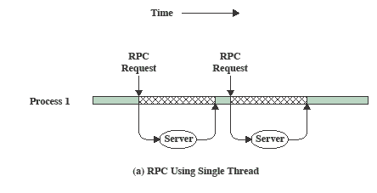
RPC Using Single Thread
Notes:
A significant issue is whether the blocking of a thread results in the blocking of the entire process. In other words, if one thread in a process is blocked, does this prevent the running of any other thread in the same process even if that other thread is in a ready state? Clearly, some of the flexibility and power of threads is lost if the one blocked thread blocks an entire process.
We return to this issue subsequently in our discussion of user-level versus kernel-level threads, but for now let us consider the performance benefits of threads that do not block an entire process. Figure 4.3 (based on one in [KLEI96]) shows a program that performs two remote procedure calls (RPCs) 2 to two different hosts to obtain a combined result. In a single-threaded program, the results are obtained in sequence, so the program has to wait for a response from each server in turn. Rewriting the program to use a separate thread for each RPC results in a substantial speedup. Note that if this program operates on a uniprocessor, the requests must be generated sequentially and the results processed in sequence; however, the program waits concurrently for the two replies.

Slide 17
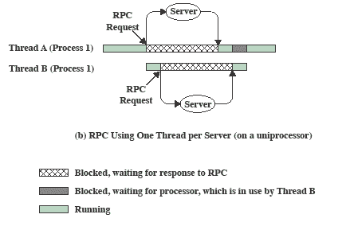
RPC Using One
Thread per Server
Notes:
Rewriting the program to use a separate thread for each RPC results in a substantial speedup.
Note that if this program operates on a uniprocessor, the requests must be generated sequentially and the results processed in sequence;
however, the program waits concurrently for the two replies.

Slide 18
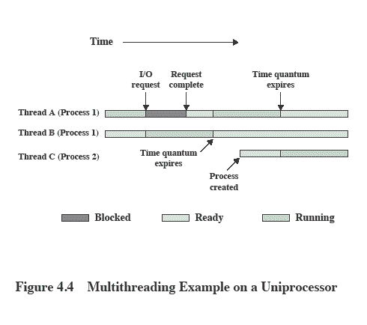

Multithreading on a Uniprocessor
Notes:
On a uniprocessor, multiprogramming enables the interleaving of multiple threads within multiple processes. In the example of Figure 4.4 , three threads in two processes are interleaved on the processor. Execution passes from one thread to another either when the currently running thread is blocked or when its time slice is exhausted.

Slide 19
Thread Synchronization
It is necessary to synchronize the activities of the various threads
      all threads of a process share the same address space and other resources
      any alteration of a resource by one thread affects the other threads in the same process
Notes:
THREAD SYNCHRONIZATION
All of the threads of a process share the same address space and other resources, such as open files. Any alteration of a resource by one thread affects the environment of the other threads in the same process. It is therefore necessary to synchronize the activities of the various threads so that they do not interfere with each other or corrupt data structures. For example, if two threads each try to add an element to a doubly linked list at the same time, one element may be lost or the list may end up malformed. The issues raised and the techniques used in the synchronization of threads are, in general, the same as for the synchronization of processes. These issues and techniques are the subject of Chapters 5 and 6 .

Slide 20
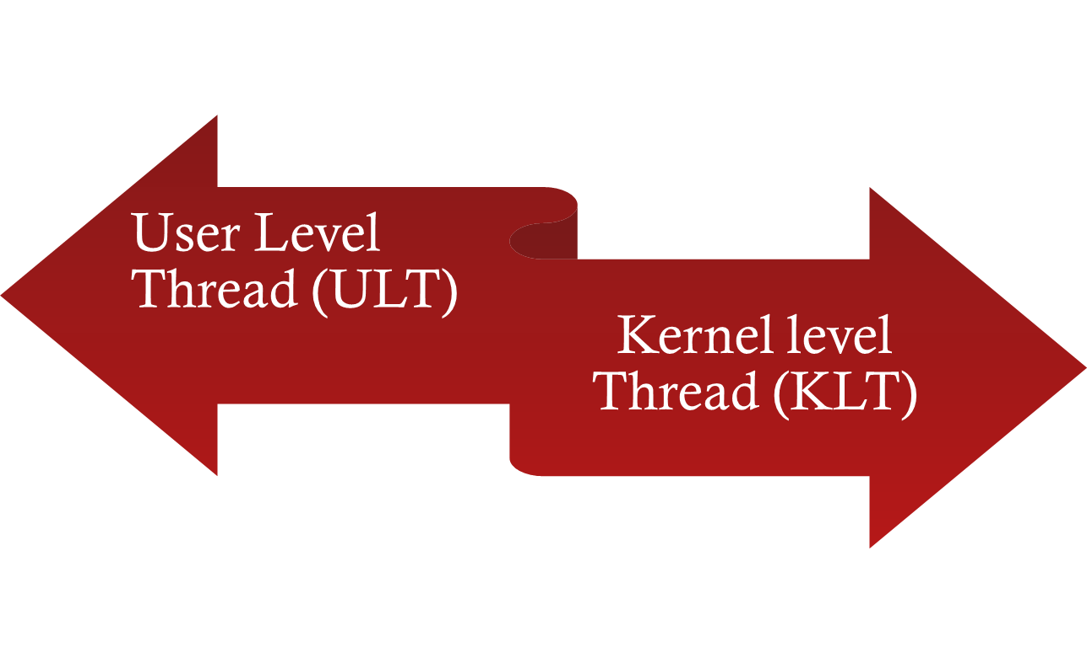

Types of Threads
NOTE: we are talking about threads for user processes. Both ULT & KLT execute in user mode. An OS may also have threads but that is not what we are discussing here.
Notes:
User-Level and Kernel-Level Threads
There are two broad categories of thread implementation: user-level threads (ULTs) and kernel-level threads (KLTs). The latter are also referred to in the literature as kernel-supported threads or lightweight processes.

Slide 21
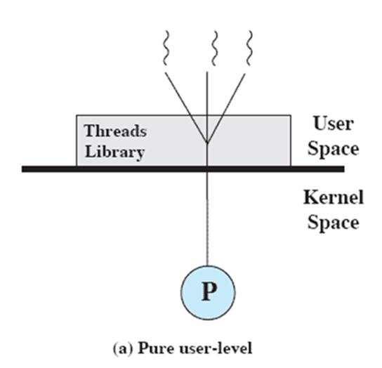
User-Level Threads (ULTs)
Thread management is done by the application
The kernel is not aware of the existence of threads
Notes:
USER-LEVEL THREADS
In a pure ULT facility, all of the work of thread management is done by the application and the kernel is not aware of the existence of threads. Figure 4.5a illustrates the pure ULT approach. Any application can be programmed to be multithreaded by using a threads library, which is a package of routines for ULT management. The threads library contains code for creating and destroying threads, for passing messages and data between threads, for scheduling thread execution, and for saving and restoring thread contexts.
By default, an application begins with a single thread and begins running in that thread. This application and its thread are allocated to a single process managed by the kernel. At any time that the application is running (the process is in the Running state), the application may spawn a new thread to run within the same process. Spawning is done by invoking the spawn utility in the threads library. Control is passed to that utility by a procedure call. The threads library creates a data structure for the new thread and then passes control to one of the threads within this process that is in the Ready state, using some scheduling algorithm. When control is passed to the library, the context of the current thread is saved, and when control is passed from the library to a thread, the context of that thread is restored. The context essentially consists of the contents of user registers, the program counter, and stack pointers.

Slide 22
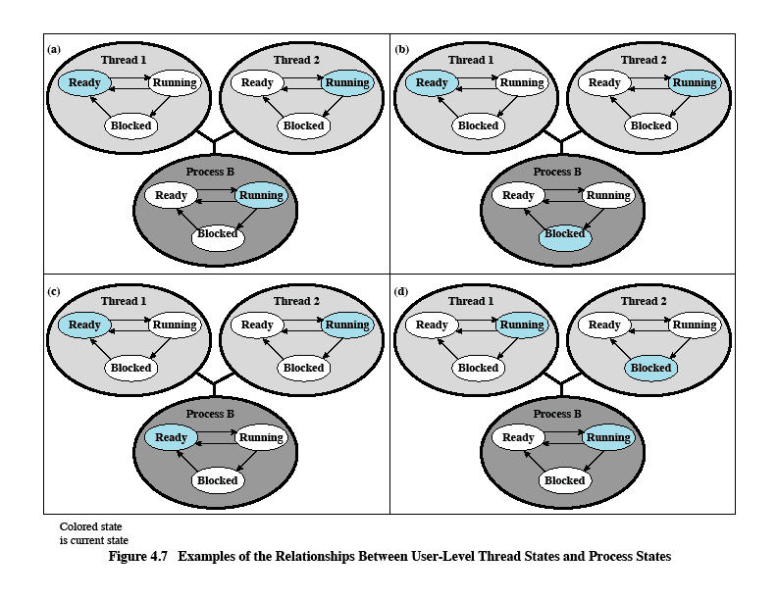
Relationships Between ULT
States and Process States
Possible transitions from 4.6a:
4.6a→4.6b
4.6a→4.6c
4.6a→4.6d
Figure 4.6 Examples of the Relationships between User-Level Thread States and Process States
Notes:
All of the activity described in the preceding paragraph takes place in user space and within a single process. The kernel is unaware of this activity. The kernel continues to schedule the process as a unit and assigns a single execution state (Ready, Running, Blocked, etc.) to that process. The following examples should clarify the relationship between thread scheduling and process scheduling. Suppose that process B is executing in its thread 2; the states of the process and two ULTs that are part of the process are shown in Figure 4.6a . Each of the following is a possible occurrence:
1. The application executing in thread 2 makes a system call that blocks B. For
example, an I/O call is made. This causes control to transfer to the kernel. The kernel invokes the I/O action, places process B in the Blocked state, and switches to another process. Meanwhile, according to the data structure maintained by the threads library, thread 2 of process B is still in the Running state. It is important to note that thread 2 is not actually running in the sense of being executed on a processor; but it is perceived as being in the Running state by the threads library. The corresponding state diagrams are shown in Figure 4.6b .
2. A clock interrupt passes control to the kernel and the kernel determines
that the currently running process (B) has exhausted its time slice. The kernel places process B in the Ready state and switches to another process. Meanwhile, according to the data structure maintained by the threads library, thread 2 of process B is still in the Running state. The corresponding state diagrams are shown in Figure 4.6c .
3. Thread 2 has reached a point where it needs some action performed by thread
1 of process B. Thread 2 enters a Blocked state and thread 1 transitions from Ready to Running. The process itself remains in the Running state. The corresponding state diagrams are shown in Figure 4.6d .
In cases 1 and 2 ( Figures 4.6b and 4.6c ), when the kernel switches control back to process B, execution resumes in thread 2. Also note that a process can be interrupted, either by exhausting its time slice or by being preempted by a higher priority process, while it is executing code in the threads library. Thus, a process may be in the midst of a thread switch from one thread to another when interrupted. When that process is resumed, execution continues within the threads library, which completes the thread switch and transfers control to another thread within that process.

Slide 23

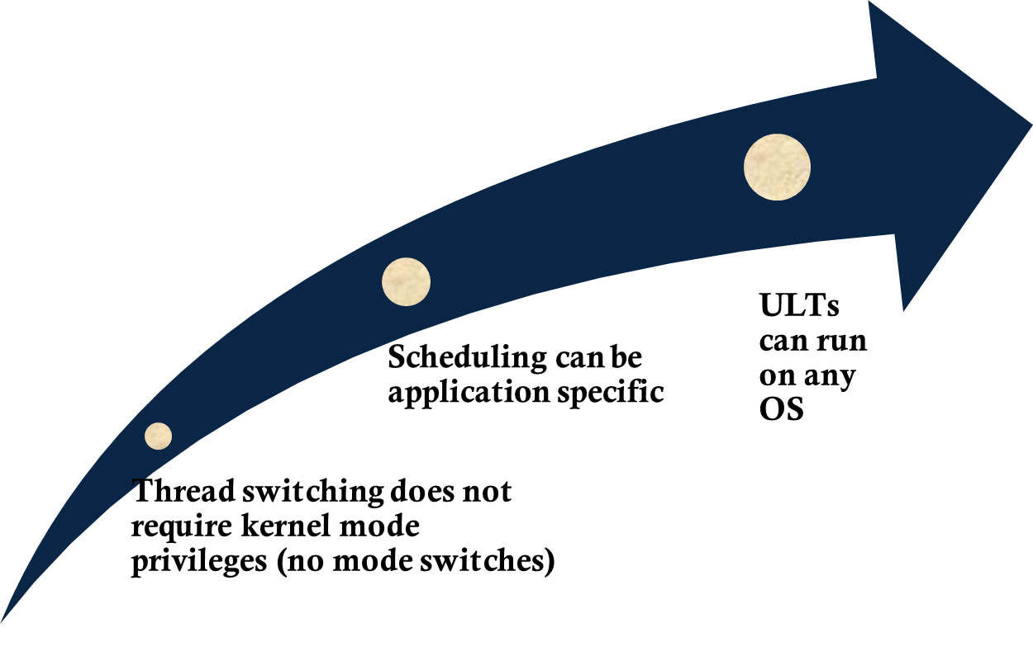
Notes:
There are a number of advantages to the use of ULTs instead of KLTs, including the following:
1. Thread switching does not require kernel mode privileges because all of the
thread management data structures are within the user address space of a single process. Therefore, the process does not switch to the kernel mode to do thread management. This saves the overhead of two mode switches (user to kernel; kernel back to user).
2. Scheduling can be application specific. One application may benefit most
from a simple round-robin scheduling algorithm, while another might benefit from a priority-based scheduling algorithm. The scheduling algorithm can be tailored to the application without disturbing the underlying OS scheduler.
3. ULTs can run on any OS. No changes are required to the underlying kernel
to support ULTs. The threads library is a set of application-level functions shared by all applications.

Slide 24

Disadvantages of ULTs
In a typical OS many system calls are blocking
    as a result, when a ULT executes a system call, not only is that thread blocked, but all of the threads within the process are blocked
In a pure ULT strategy, a multithreaded application cannot take advantage of multiprocessing
Notes:
There are two distinct disadvantages of ULTs compared to KLTs:
1. In a typical OS, many system calls are blocking. As a result, when a ULT
executes a system call, not only is that thread blocked, but also all of the threads within the process are blocked.
2. In a pure ULT strategy, a multithreaded application cannot take advantage
of multiprocessing. A kernel assigns one process to only one processor at a time. Therefore, only a single thread within a process can execute at a time. In effect, we have application-level multiprogramming within a single process. While this multiprogramming can result in a significant speedup of the application, there are applications that would benefit from the ability to execute portions of code simultaneously.

Slide 25
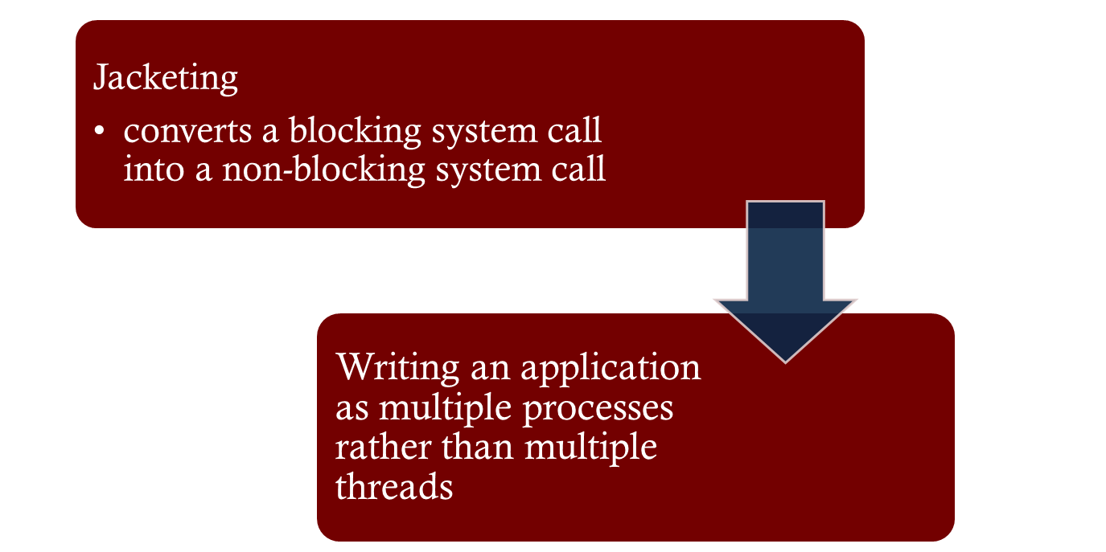

Overcoming ULT Disadvantages
Notes:
There are ways to work around these two problems. For example, both problems can be overcome by writing an application as multiple processes rather than multiple threads. But this approach eliminates the main advantage of threads: Each switch becomes a process switch rather than a thread switch, resulting in much
greater overhead. Another way to overcome the problem of blocking threads is to use a technique referred to as jacketing . The purpose of jacketing is to convert a blocking
system call into a non-blocking system call. For example, instead of directly calling a system I/O routine, a thread calls an application-level I/O jacket routine. Within this jacket routine is code that checks to determine if the I/O device is busy. If it is, the thread enters the Blocked state and passes control (through the threads library) to another thread. When this thread later is given control again, the jacket routine checks the I/O device again.

Slide 26
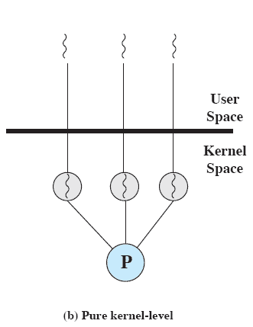
Kernel-Level Threads (KLTs)
  Thread management is done by the kernel (could call them KMT)
      no thread management is done by the application
    Windows is an example of this approach
Notes:
KERNEL-LEVEL THREADS
In a pure KLT facility, all of the work of thread management is done by the kernel. There is no thread management code in the application level, simply an application programming interface (API) to the kernel thread facility. Windows is an example of this approach. Figure 4.5b depicts the pure KLT approach. The kernel maintains context
information for the process as a whole and for individual threads within the process.

Slide 27
Advantages of KLTs
The kernel can simultaneously schedule multiple threads from the same process on multiple processors
If one thread in a process is blocked, the kernel can schedule another thread of the same process
Notes:
Scheduling by the kernel is done on a thread basis. This approach overcomes the two principal drawbacks of the ULT approach. First, the kernel can simultaneously schedule multiple threads from the same process on multiple processors. Second, if one thread in a process is blocked, the kernel can schedule another thread of the same process. Another advantage of the KLT approach is that kernel routines themselves can be multithreaded.

Slide 28
Multicore Programming
Multicore or multiprocessor systems putting pressure on programmers, challenges include:
  Dividing activities
  Balance
  Data splitting
  Data dependency
  Testing and debugging
Parallelism implies a system can perform more than one task simultaneously
Concurrency supports more than one task making progress
  Single processor / core, scheduler providing concurrency

Slide 29
Multicore Programming (Cont.)
As # of threads grows, so does architectural support for threading
  CPUs have cores as well as hardware threads
  Consider Oracle SPARC T4 with 8 cores, and
Types of parallelism
  Data parallelism – distributes subsets of the same data across multiple cores, same operation on each
  Task parallelism – distributing threads across cores, each thread performing unique operation
As # of threads grows, so does architectural support for threading
  CPUs have cores as well as hardware threads
  Consider Oracle SPARC T4 with 8 cores, and 8 hardware threads per core

Slide 30


Concurrency vs. Parallelism
Concurrent execution on single-core system:
Parallelism on a multi-core system:

Slide 31
Multithreading Models
Many-to-One
One-to-One
Many-to-Many

Slide 32

Many-to-One
Many user-level threads mapped to single kernel thread
One thread blocking causes all to block
Multiple threads may not run in parallel on muticore system because only one may be in kernel at a time
Few systems currently use this model
Examples:
  Solaris Green Threads
  GNU Portable Threads

Slide 33

One-to-One
Each user-level thread maps to kernel thread
Creating a user-level thread creates a kernel thread
More concurrency than many-to-one
Number of threads per process sometimes restricted due to overhead
Examples
  Windows
  Linux
  Solaris 9 and later

Slide 34

Many-to-Many Model
Allows many user level threads to be mapped to many kernel threads
Allows the operating system to create a sufficient number of kernel threads
Solaris prior to version 9
Windows with the ThreadFiber package

Slide 35

Two-level Model
The two-level model is similar to the many-to-many model but also allows for certain user-level threads to be bound to a single kernel-level thread.
_x000b_

Slide 36
Implicit Threading
Growing in popularity as numbers of threads increase, program correctness more difficult with explicit threads
Creation and management of threads done by compilers and run-time libraries rather than programmers
Three methods explored
  Thread Pools
  OpenMP
  Grand Central Dispatch
Other methods include Microsoft Threading Building Blocks (TBB), java.util.concurrent package

Slide 37

Thread Pools
Create a number of threads in a pool where they await work
Advantages:
  Usually slightly faster to service a request with an existing thread than create a new thread
  Allows the number of threads in the application(s) to be bound to the size of the pool
  Separating task to be performed from mechanics of creating task allows different strategies for running task
    i.e.Tasks could be scheduled to run periodically
Windows API supports thread pools:

Slide 38
Threading Issues
Semantics of fork() and exec() system calls
Signal handling
  Synchronous and asynchronous
Thread cancellation of target thread
  Asynchronous or deferred
Thread-local storage
Scheduler Activations

Slide 39
Semantics of fork() and exec()
Does fork()duplicate only the calling thread or all threads?
  Some UNIXes have two versions of fork
exec() usually works as normal – replace the running process including all threads

Slide 40
Signal Handling
Signals are used in UNIX systems to notify a process that a particular event has occurred.
A signal handler is used to process signals
  Signal is generated by particular event
  Signal is delivered to a process
  Signal is handled by one of two signal handlers:
    default
    user-defined
Every signal has default handler that kernel runs when handling signal
  User-defined signal handler can override default
  For single-threaded, signal delivered to process

Slide 41
Signal Handling (Cont.)
Where should a signal be delivered for multi-threaded?
  Deliver the signal to the thread to which the signal applies
  Deliver the signal to every thread in the process
  Deliver the signal to certain threads in the process
  Assign a specific thread to receive all signals for the process

Slide 42

Thread Cancellation
Terminating a thread before it has finished
Thread to be canceled is target thread
Two general approaches:
  Asynchronous cancellation terminates the target thread immediately
  Deferred cancellation allows the target thread to periodically check if it should be cancelled
Pthread code to create and cancel a thread:

Slide 43

Thread Cancellation (Cont.)
Invoking thread cancellation requests cancellation, but actual cancellation depends on thread state
If thread has cancellation disabled, cancellation remains pending until thread enables it
Default type is deferred
  Cancellation only occurs when thread reaches cancellation point
    I.e. pthread_testcancel()
    Then cleanup handler is invoked
On Linux systems, thread cancellation is handled through signals

Slide 44
Thread-Local Storage
Thread-local storage (TLS) allows each thread to have its own copy of data
Useful when you do not have control over the thread creation process (i.e., when using a thread pool)
Different from local variables
  Local variables visible only during single function invocation
  TLS visible across function invocations
Similar to static data
  TLS is unique to each thread

Slide 45

Scheduler Activations
Both M:M and Two-level models require communication to maintain the appropriate number of kernel threads allocated to the application
Typically use an intermediate data structure between user and kernel threads – lightweight process (LWP)
  Appears to be a virtual processor on which process can schedule user thread to run
  Each LWP attached to kernel thread
  How many LWPs to create?
Scheduler activations provide upcalls - a communication mechanism from the kernel to the upcall handler in the thread library
This communication allows an application to maintain the correct number kernel threads

